Slide 1
DAVI Individual CA1
Ernest Ng

Slide 2
TABLE OF CONTENTS
01
02
03
TOPIC QUESTION
GRAPHS & STORYBOARD
CONCLUSION
Here you could describe the topic of the section
Here you could describe the topic of the section
Here you could describe the topic of the section

Slide 3
01
Topic Question
Your family’s relatives family of 6 are looking to move to a new house in Singapore as their family is too large for their current house, and as the only property agent in the family, they want to ask you to help them find the best value hdb in Singapore, with a budget of $35/sqm and sqm of 120m and below 400k in resale price
MYHOME
REAL ESTATE

Slide 4
02
Graphs and StoryBoards

Slide 5
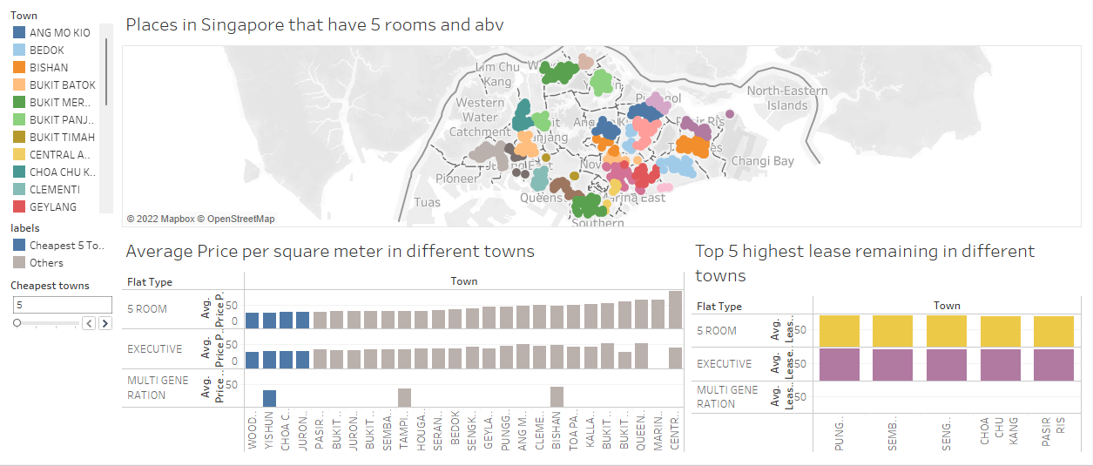

Slide 6
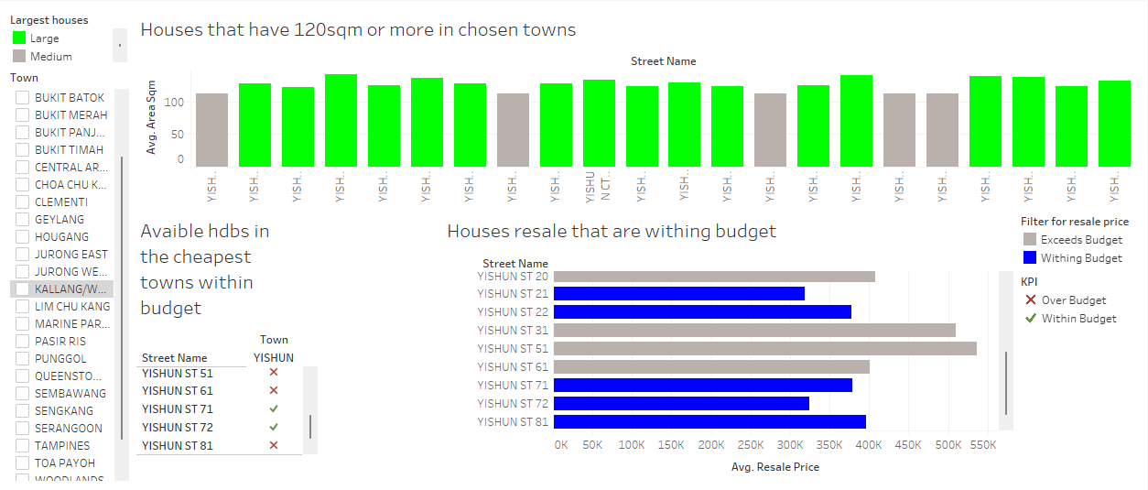

Slide 7
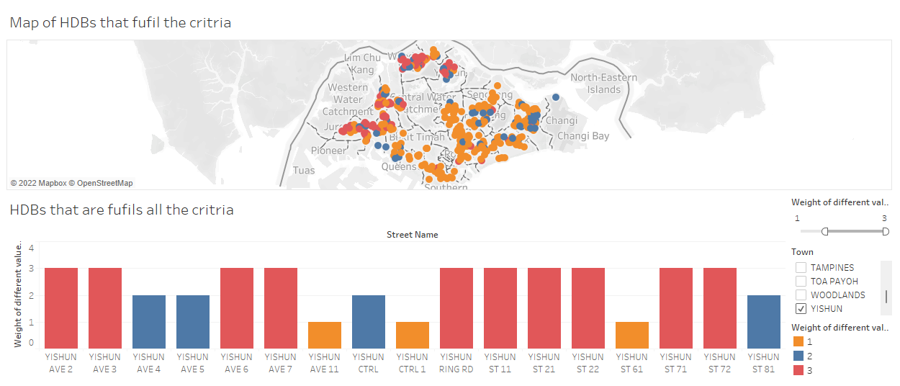

Slide 8
03
Conclusion
Notes:
To conclude the houses that satisfy my relatives requirements are the ones in red

Slide 9
THANKS
Does anyone have any questions?
Ernestng.22@ichat.sp.edu.sg
+91 620 421 838

